Slide 1
Assignment 2 Probe Data Analysis for Road Slope
Christopher Morcom and Brianna Bransfield
CS 513

Slide 2
Assignment Tasks
Given Probe data and map
Map match probe points to road links
Derive road slope for each road link
Evaluate the derived road slope with the surveyed road slope in the link data file

Slide 3
Our Goals
Match each probe point to the closest map link
Calculate perpendicular distance from link and distance from the ref node
Used Python and UTM
Notes:
Match each prope point to closest map link
Calculate perpendicular dist from link and idst from ref node

Slide 4
Input Files
Partition6467ProbePoints.csv
(Bounded rectangle - 50.62500, 8.43751, 53.43750, 11.25000)
Partition6467LinkData.csv
(Map Links)

Slide 5
The Process
Read all data using UTM coordinates
Read Map links into B+ Tree Backed with ordered hashtable (B Tree Backed by 2D hashtable)
Binary search on each probe point
Look through tree in constant time
Find where point is located based on UTM

Slide 6
The Process Continued
Look at the surrounding points off of the x coordinate
Gather 5 points ( 2 to the left, 2 to the right, middle point) and search for the closest y value
Uses iterative approach
Given in constant time - can’t multithread it

Slide 7
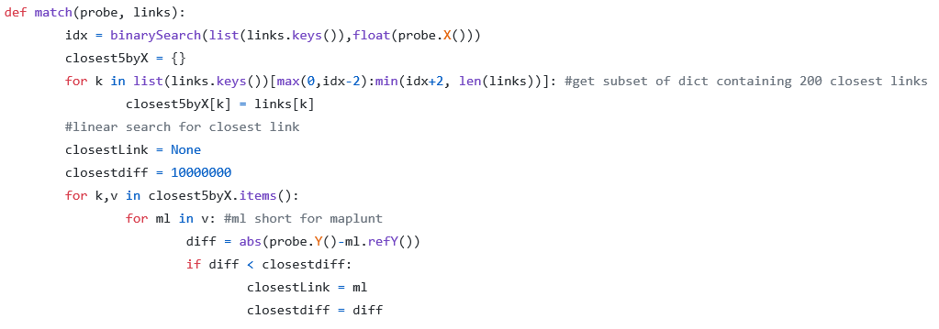

Slide 8
The Process Continued
Calculate distance from ref node and perpendicular distance
Assuming the link is approx. a straight line between ref node and non ref node
If the point isn’t contained within the domain of the link, we extrapolate our line instead of trying to rematch the point

Slide 9
The Process Continued
Take UTM coordinate of each link and calculate approximate slope based off of simple difference in altitude
Derived slope - match against slope provided in and link data to get the error

Slide 10
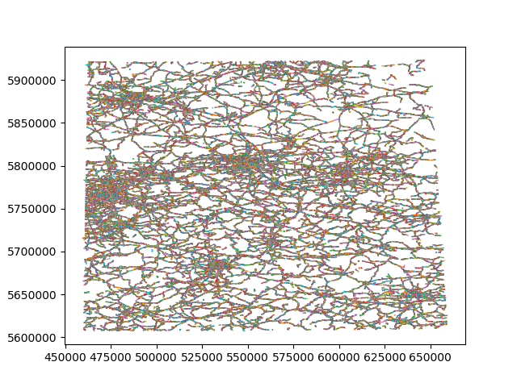
Graph of all 200089 Map Links

Slide 11
Results
About 10% of the data was matched correctly
Errors range from ~0% - 1,600% depending on the concentration of links and how many points there were per link

Slide 12
Analysis
Using the process we were able to match points for approximately 10% of the data, however we were able to do it in constant time O(1) without having to use an iterative-closest-point (ICP) search which takes O(nlogn) time
This approach seems to work for small data sets of < 50,000 map links to match probe points to

Slide 13
Future Improvements
Since we didn’t multithread we could only process 45 - 50% of the data
Our algorithm uses a unique data structure, but we should be able to optimize it further to approach a more realistic O(1) time complexity with a much smaller time complexity so we can run this on the go
Chunking the data by preprocessing is also another important feature to have to increase accuracy

